Slide 1

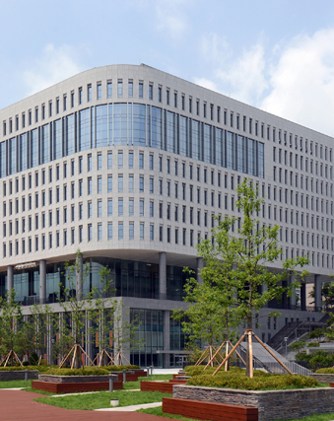
Problem Solving & Experiment Team Standing Comedy
20175532 신동진
20140661 신주환
20146136 오준오
20141001 이지호
20141405 최형준

Slide 2

목차
1. Problem Solving
2. UI & Story Board
3. Parsing
4. Algorithm

Slide 3
Problem Solving
Structure of graph
Which Data Structure will be used?
Structure of nodes

Slide 4
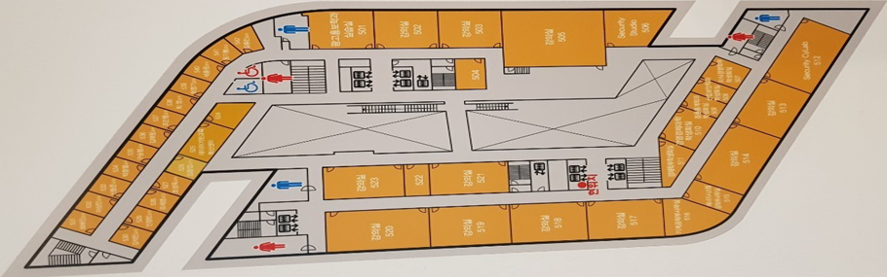
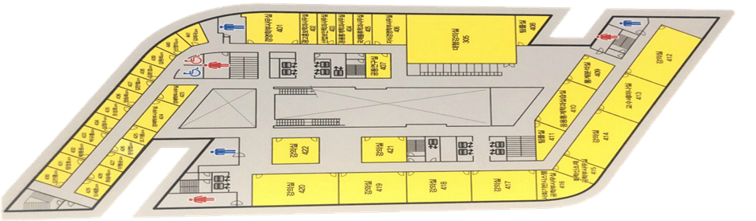
Structure of Graph
2D Graph
Node : classroom, elevator, stairs
Floor movement is only possible through stairs or elevator.
The nodes are connected with an edge IF
Two classrooms are adjacent
Closest classroom with stairs or elevator
Elevator or stairs itself in adjacent floors

Slide 5
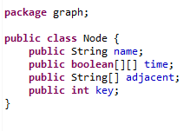
Structure of Nodes
Each node has information about
It’s name.
A timetable. (which can check if a classroom is not in use)
Nodes connected to it with edges.
A key which is used as an index.

Slide 6
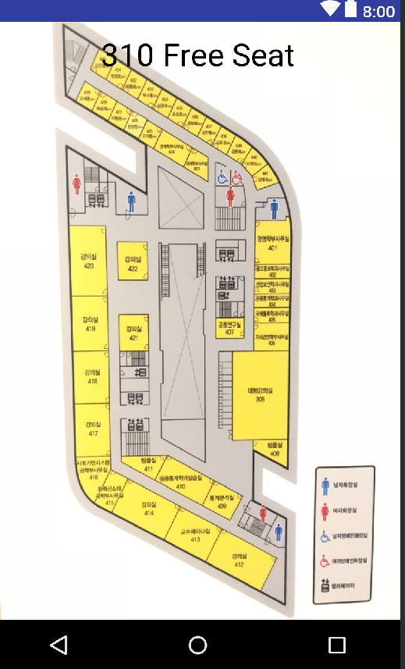
UI & Storyboard
Input
Time (can get current time)
Current location
Length of free time
Output
Location of free classroom

Slide 7
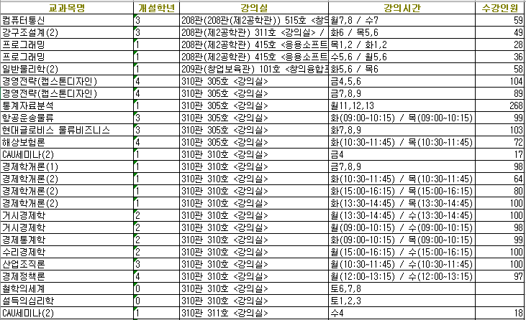
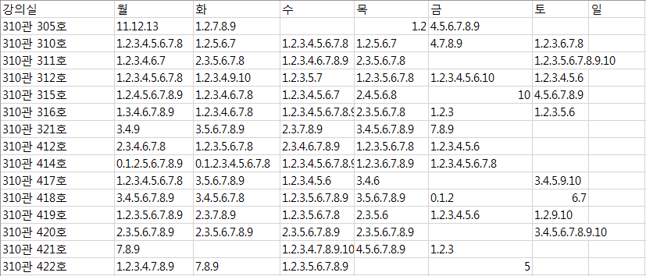
Parsing
Format conversion
Delete unavailable rooms
Handle lectures that do not fit on an hourly table is treated like taking over an hour.

Slide 8
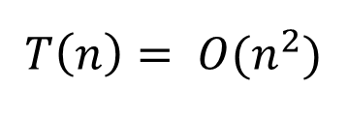
Algorithm
Find an empty classroom with the shortest time through the BFS in the empty classroom list.
$$T\left(n\right)= O(n^{2})$$

Slide 9
Q & A

